Slide 1

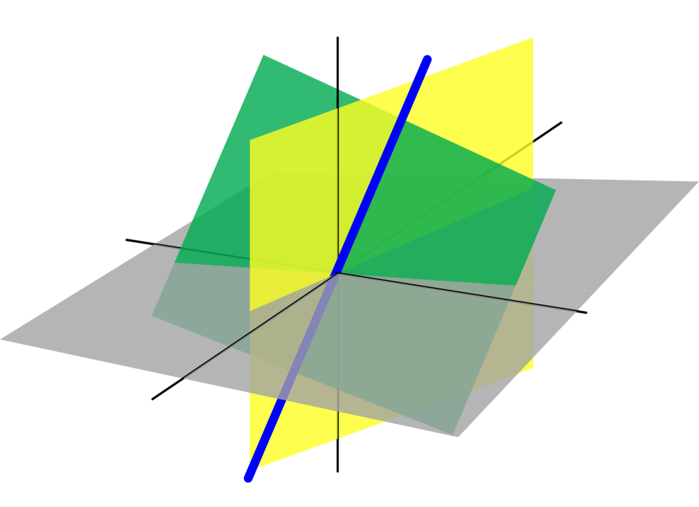
Azərbaycan Dövlət Neft və Sənaye Universiteti
Analytic Geometry

Slide 2
Introduction to
Analytic Geometry

Slide 3
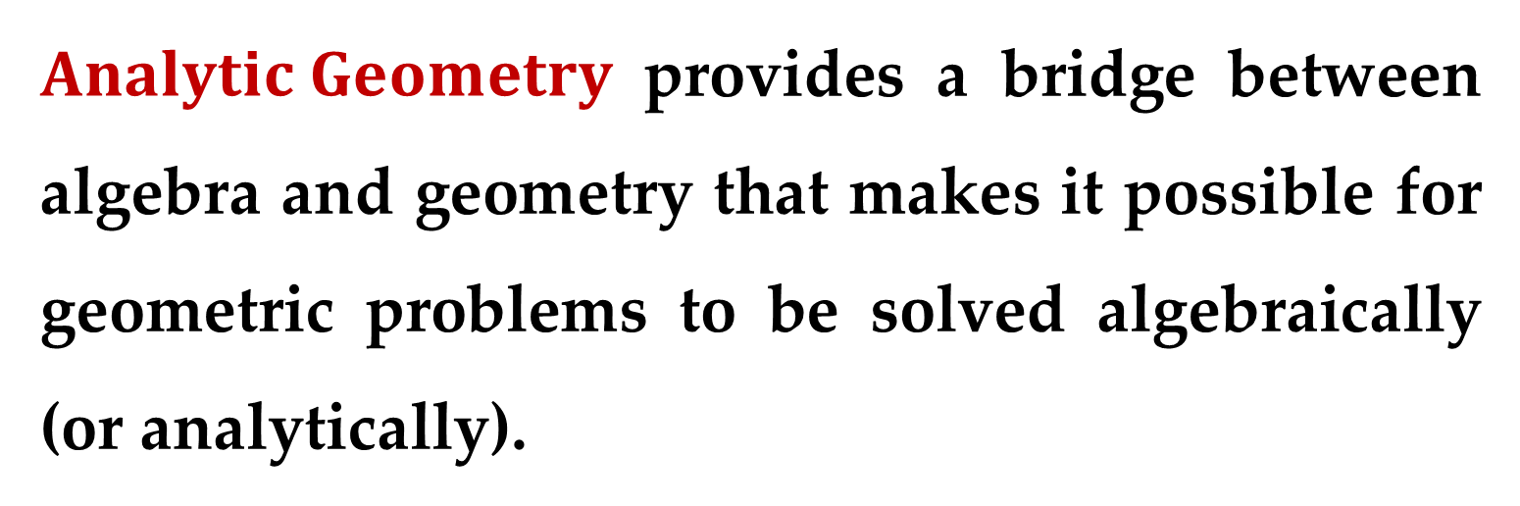
$Analytic Geometry$ provides a bridge between algebra and geometry that makes it possible for geometric problems to be solved algebraically (or analytically).
It also allows us to solve algebraic problems geometrically.
But the former is far more important, especially when numbers are assigned to geometric concepts.

Slide 4
Consider, for instance, the length of a line segment or the angle between two lines.
Even if the lines and points are accurately known, the number representing the length of a segment or the angle between two lines can be determined only approximately by direct measurement.
Algebraic methods, however, provide an exact determination of the number.

Slide 5
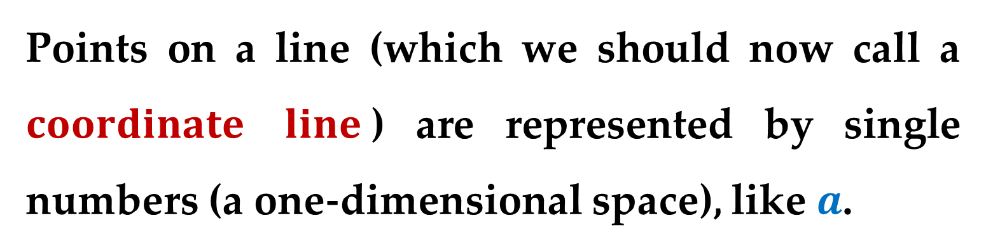
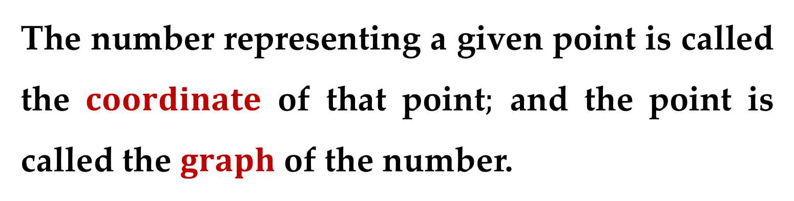
The association between algebra and geometry is made by assigning numbers to points.
The number representing a given point is called the $coordinate$ of that point$;$ and the point is called the $graph$ of the number.
Points on a line (which we should now call a $coordinate$ $line$) are represented by single numbers (a one-dimensional space), like $a$.

Slide 6
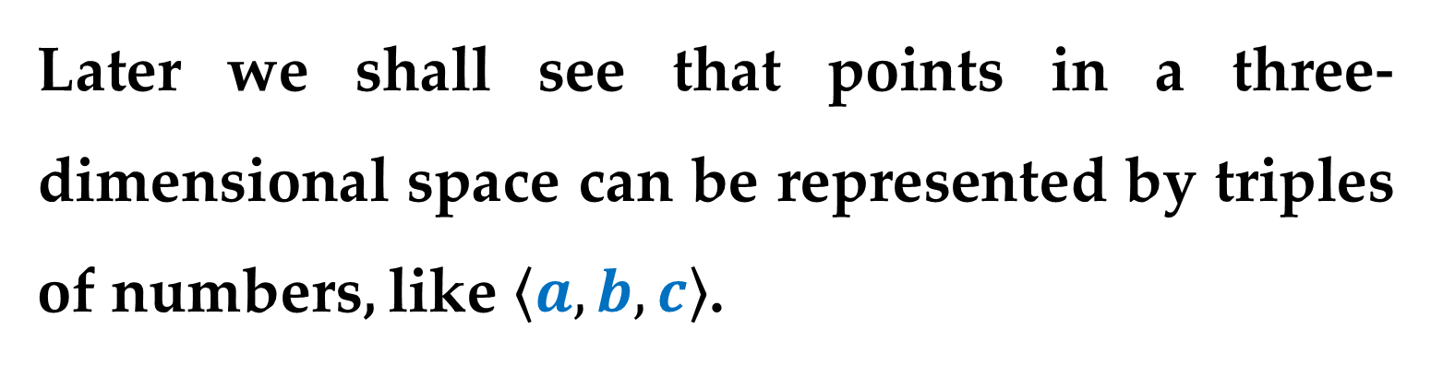
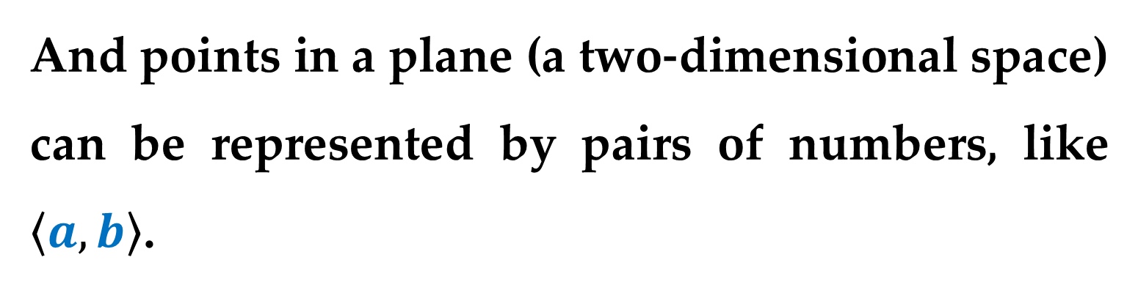
And points in a plane (a two-dimensional space) can be represented by pairs of numbers, like $\left\langle a,b\right\rangle$.
Later we shall see that points in a three- dimensional space can be represented by triples of numbers, like $\left\langle a,b,c\right\rangle$.

Slide 7
Analytic Geometry
in Two Dimensions

Slide 8
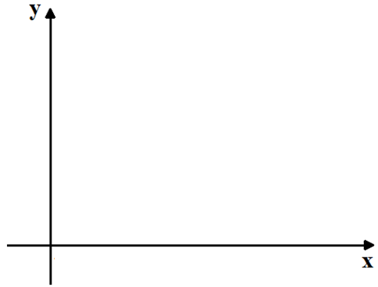
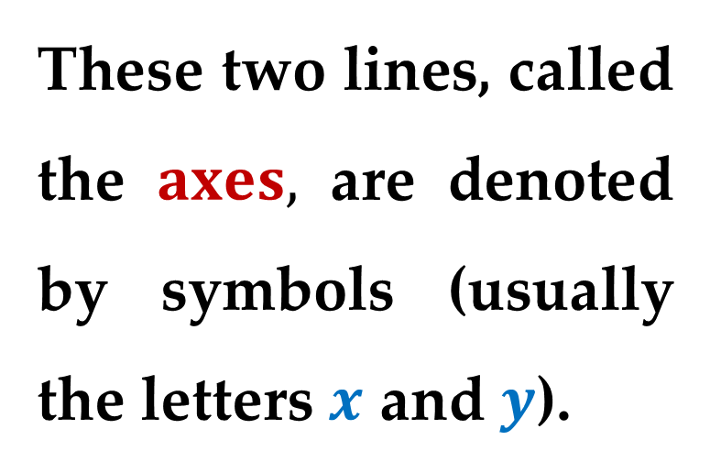
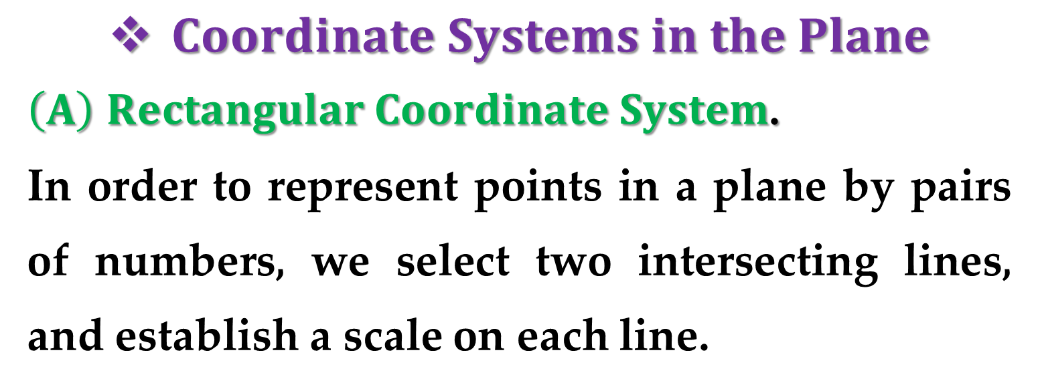
$Coordinate Systems in the Plane$
$\left(A\right)$ $Rectangular Coordinate System$.
In order to represent points in a plane by pairs of numbers, we select two intersecting lines, and establish a scale on each line.
These two lines, called the $axes,$ are denoted by symbols (usually the letters $x$ and $y$).

Slide 9
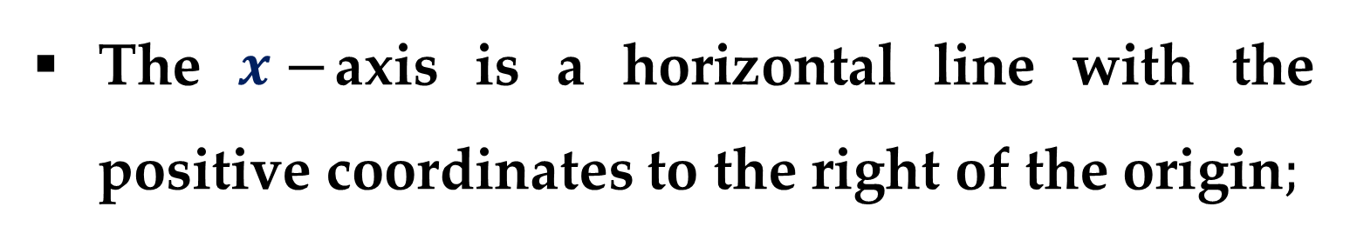
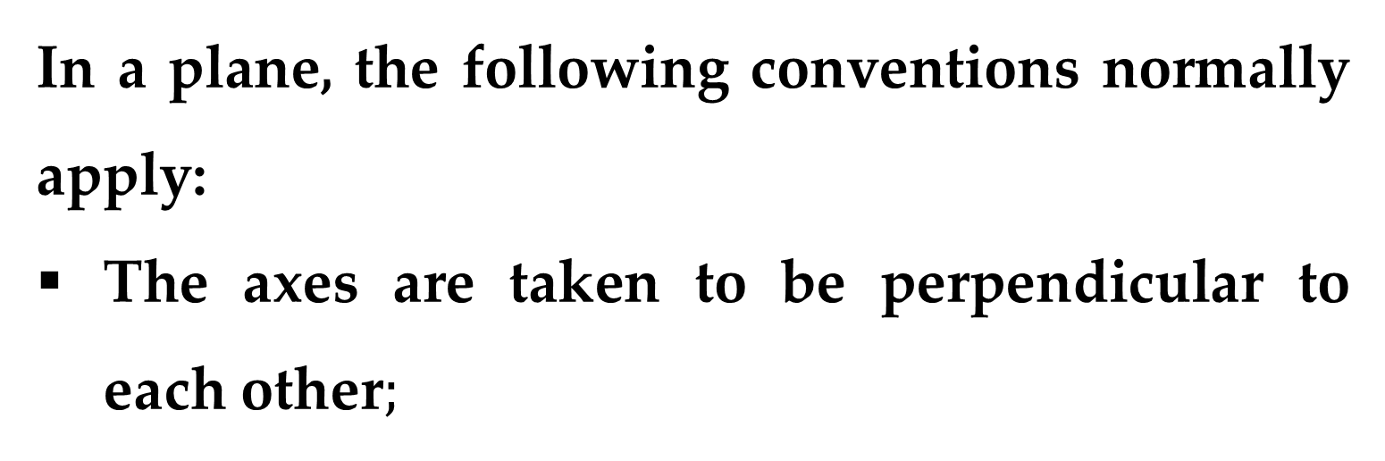
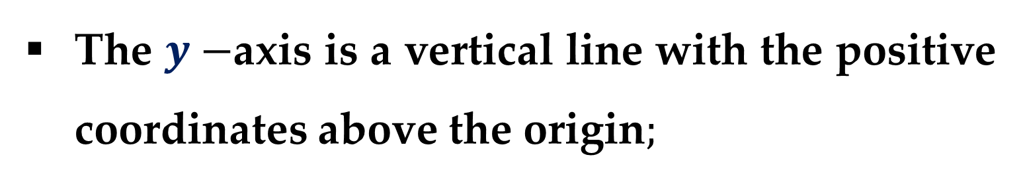
In a plane, the following conventions normally apply:
The axes are taken to be perpendicular to each other$;$
The $x−$axis is a horizontal line with the positive coordinates to the right of the origin$;$
The $y−$axis is a vertical line with the positive coordinates above the origin$;$
The same scale is used on both axes.

Slide 10
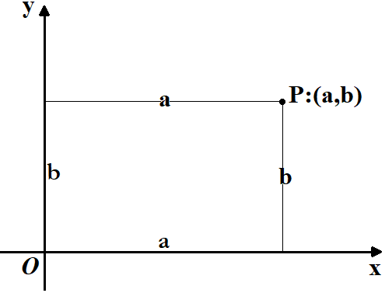
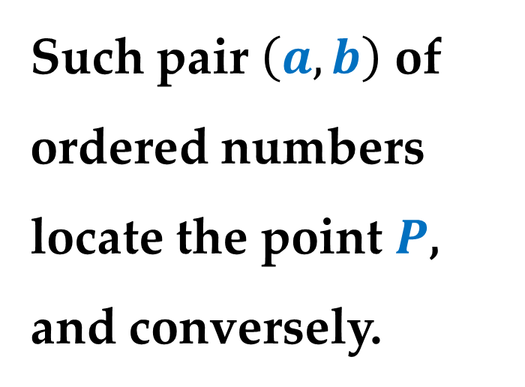
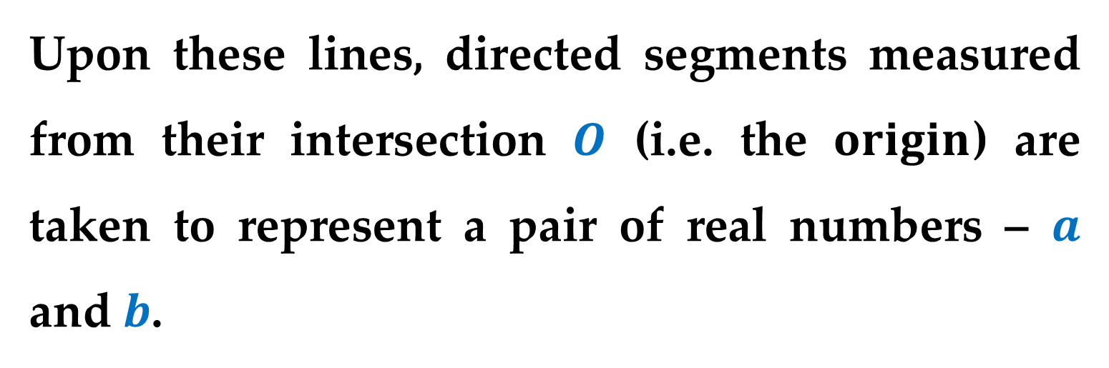

The point of intersection is called the $origin$.
Upon these lines, directed segments measured from their intersection $O$ (i.e. the $origin$) are taken to represent a pair of real numbers – $a$ and $b$.
Such pair $\left(a,b\right)$ of ordered numbers locate the point $P$, and conversely.

Slide 11

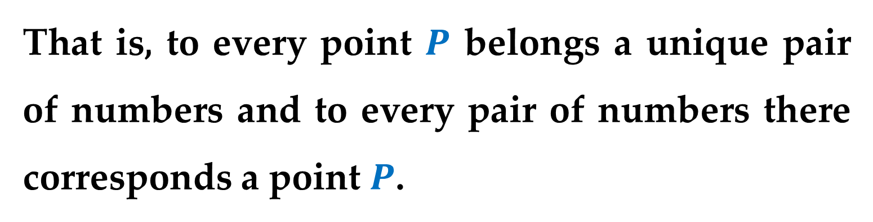
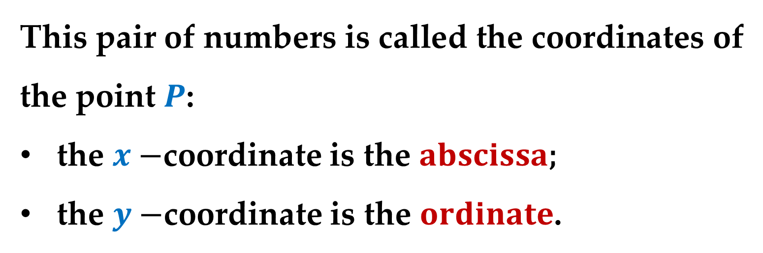
That is, to every point $P$ belongs a unique pair of numbers and to every pair of numbers there corresponds a point $P$.
This is a $one−to−one correspondence$.
This pair of numbers is called the coordinates of the point $P$:
the $x−$coordinate is the $abscissa$;
the $y−$coordinate is the $ordinate$.

Slide 12
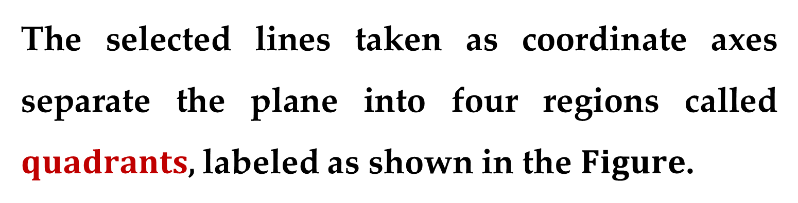
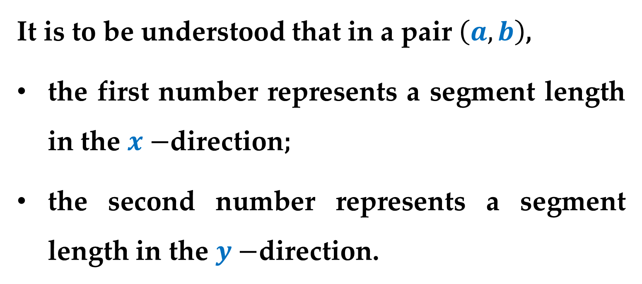
It is to be understood that in a pair $\left(a,b\right)$,
the first number represents a segment length in the $x−$direction;
the second number represents a segment length in the $y−$direction.
The selected lines taken as coordinate axes separate the plane into four regions called $quadrants$, labeled as shown in the $Figure$.

Slide 13
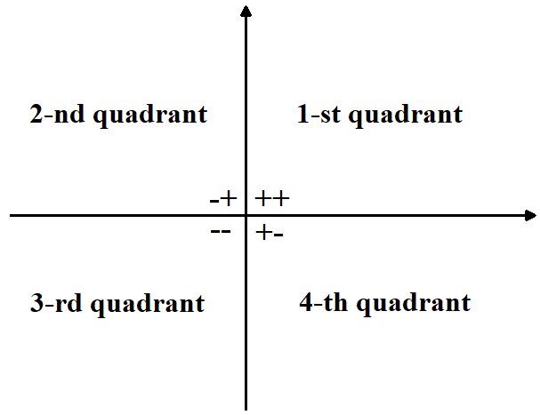
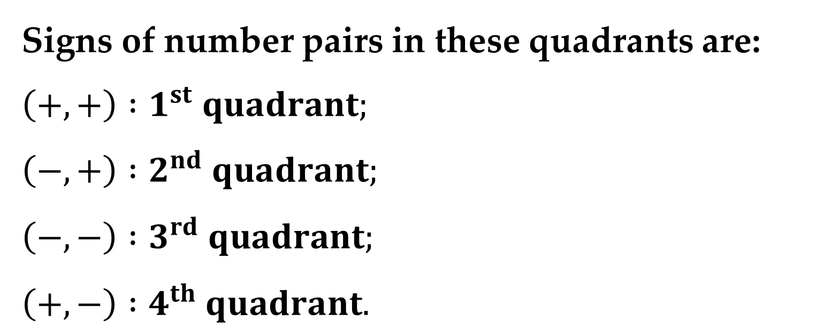
Signs of number pairs in these quadrants are:
$\left(+,+\right) :1^{st} quadrant;$
$\left(−,+\right) :2^{nd} quadrant;$
$\left(−, −\right) :3^{rd} quadrant;$
$\left(+,−\right) :4^{th} quadrant.$

Slide 14
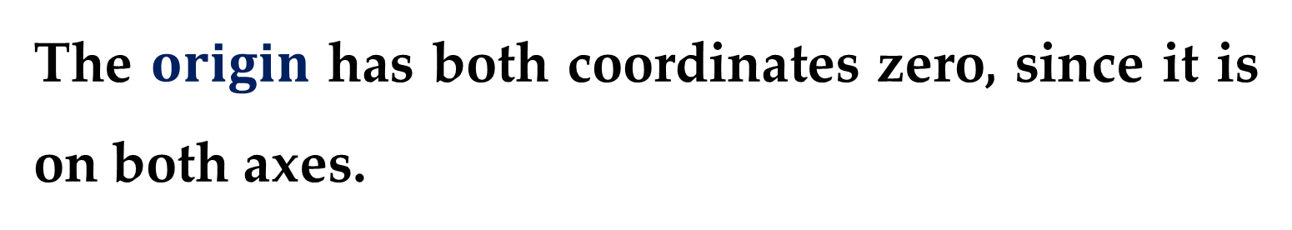
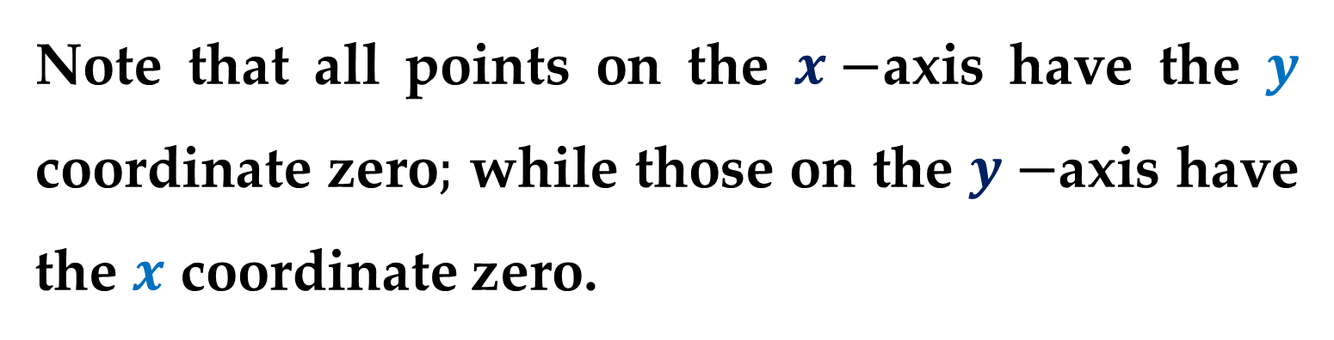
Note that all points on the $x−$axis have the $y$ coordinate zero$;$ while those on the $y−$axis have the $x$ coordinate zero.
The $origin$ has both coordinates zero, since it is on both axes.
Note that the points on the axes are not in any quadrant.

Slide 15
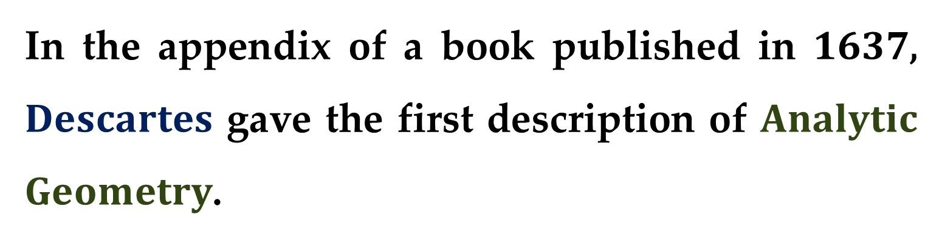
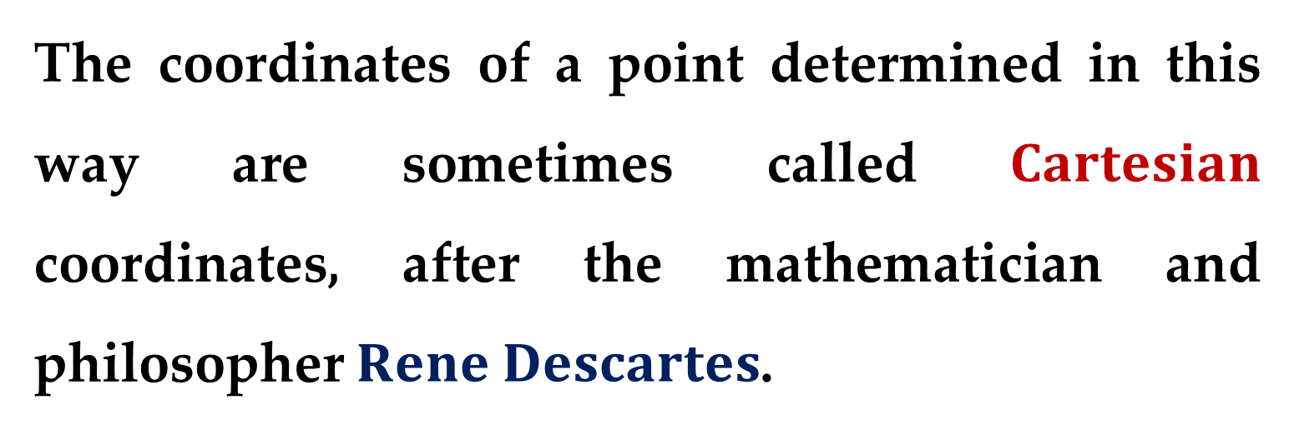
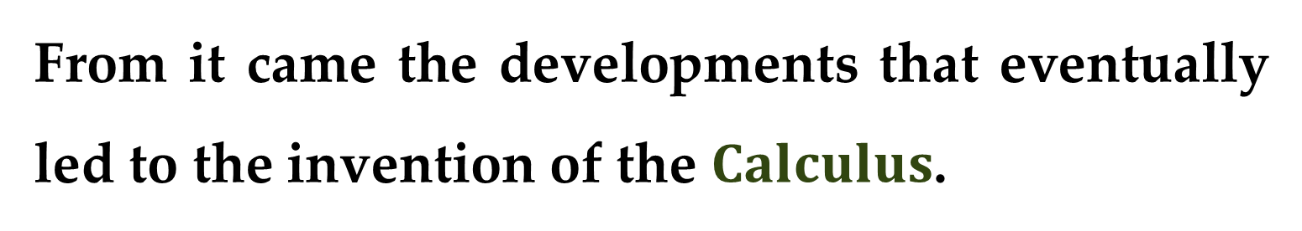
The coordinates of a point determined in this way are sometimes called $Cartesian$ coordinates, after the mathematician and philosopher $Rene Descartes$.
In the appendix of a book published in $1637$, $Descartes$ gave the first description of $Analytic$ $Geometry$.
From it came the developments that eventually led to the invention of the $Calculus$.

Slide 16
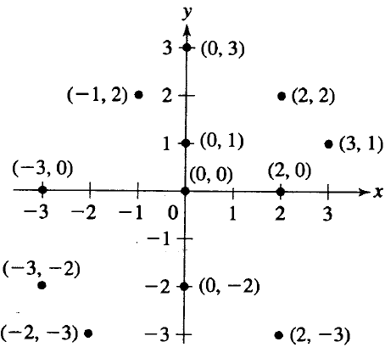
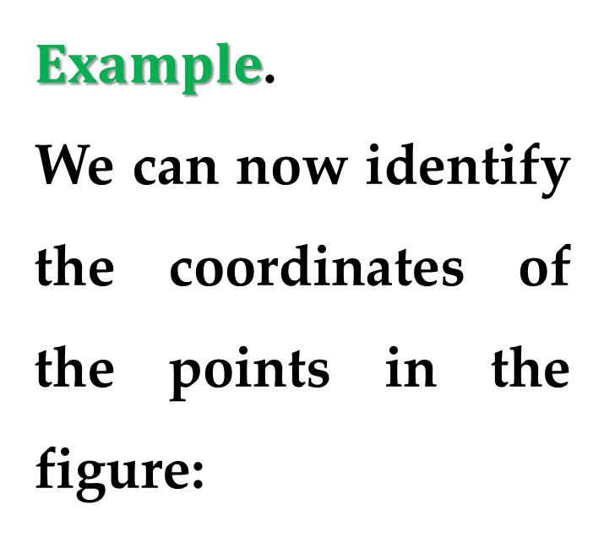
$Example$.
We can now identify the coordinates of the points in the figure:

Slide 17
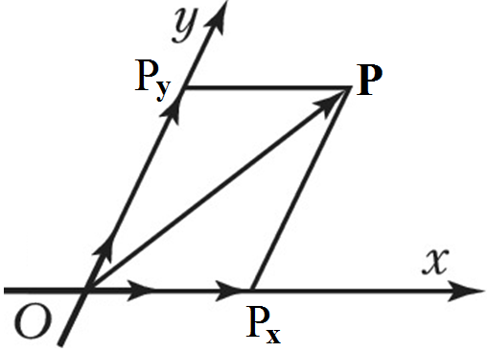
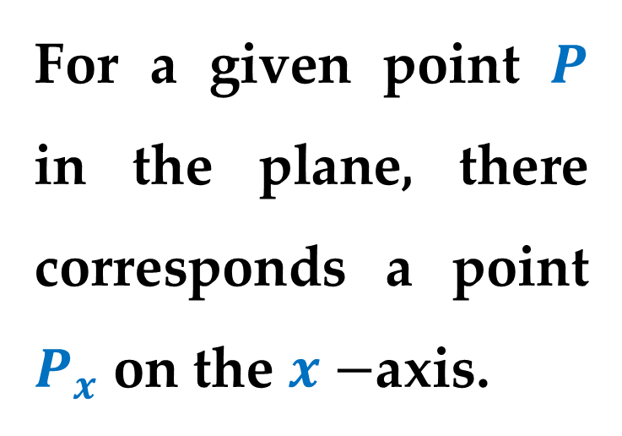
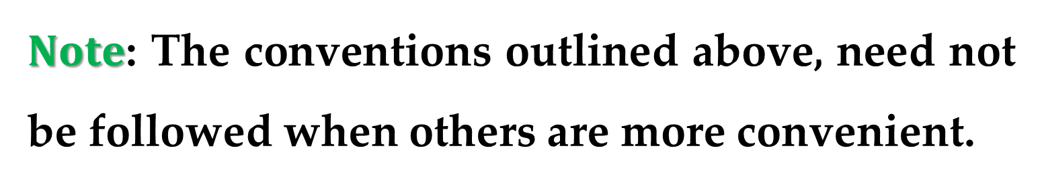
$Note$: The conventions outlined above, need not be followed when others are more convenient.
For example, we can also define in a plane an oblique coordinate system (or affine coordinate system).
For a given point $P$ in the plane, there corresponds a point $P_{x}$ on the $x−$axis.

Slide 18
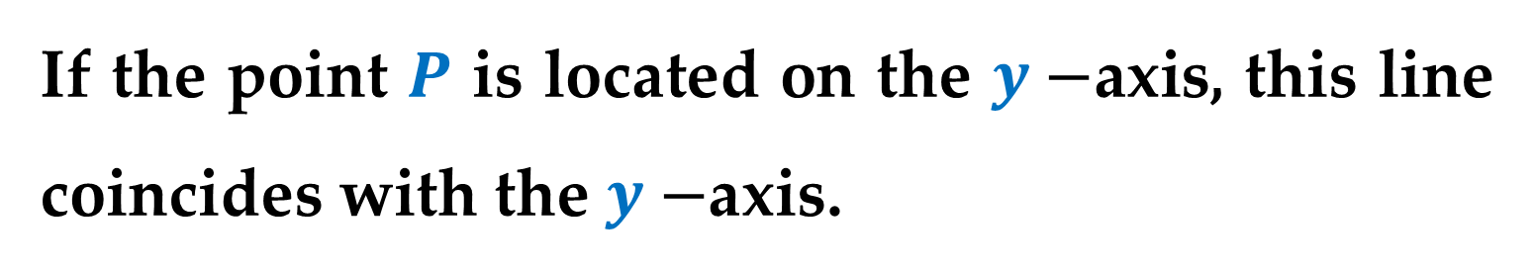
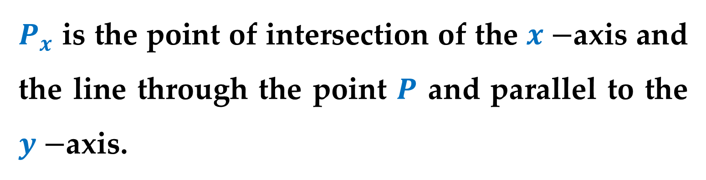
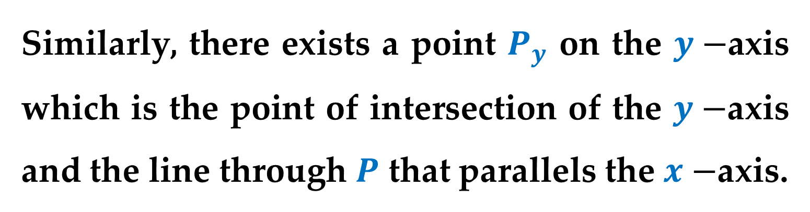
$P_{x}$ is the point of intersection of the $x−$axis and the line through the point $P$ and parallel to the $y−$axis.
If the point $P$ is located on the $y−$axis, this line coincides with the $y−$axis.
Similarly, there exists a point $P_{y}$ on the $y−$axis which is the point of intersection of the $y−$axis and the line through $P$ that parallels the $x−$axis.

Slide 19
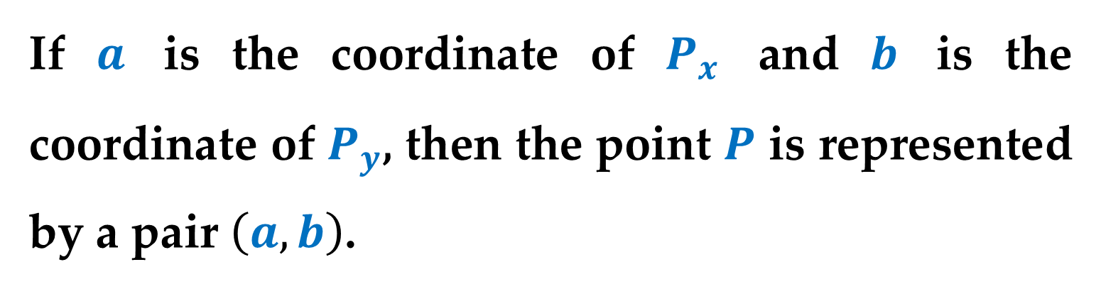
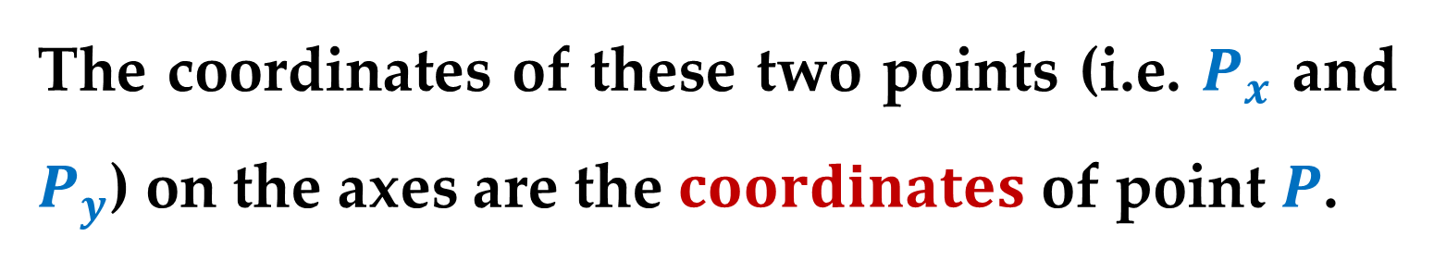
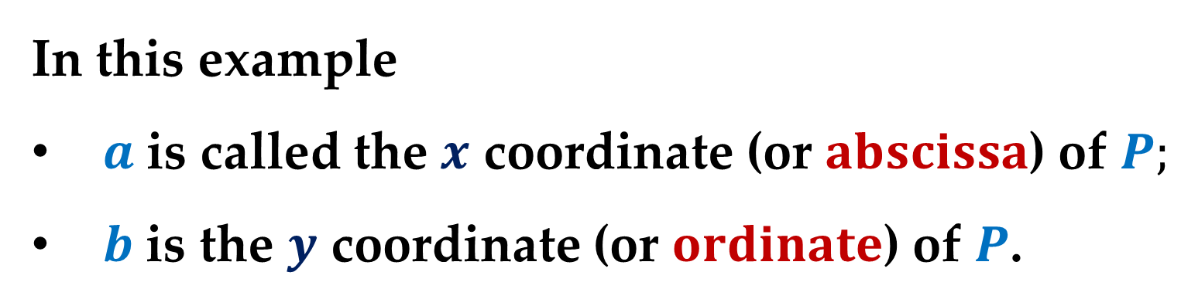
The coordinates of these two points (i.e. $P_{x}$ and $P_{y}$) on the axes are the $coordinates$ of point $P$.
If $a$ is the coordinate of $P_{x}$ and $b$ is the coordinate of $P_{y}$, then the point $P$ is represented by a pair $\left(a,b\right)$.
In this example
$a$ is called the $x$ coordinate (or $abscissa$) of $P;$
$b$ is the $y$ coordinate (or $ordinate$) of $P$.

Slide 20
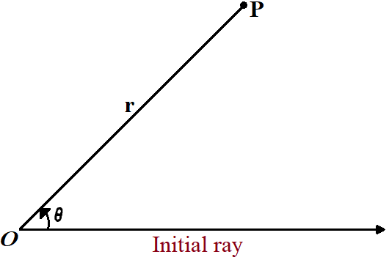
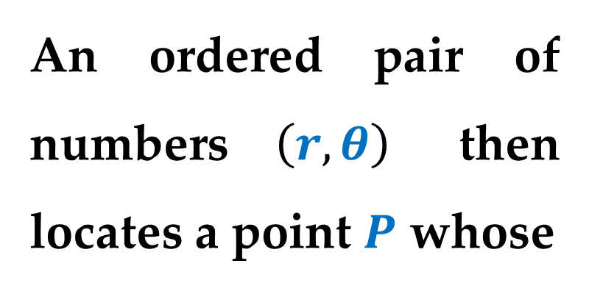
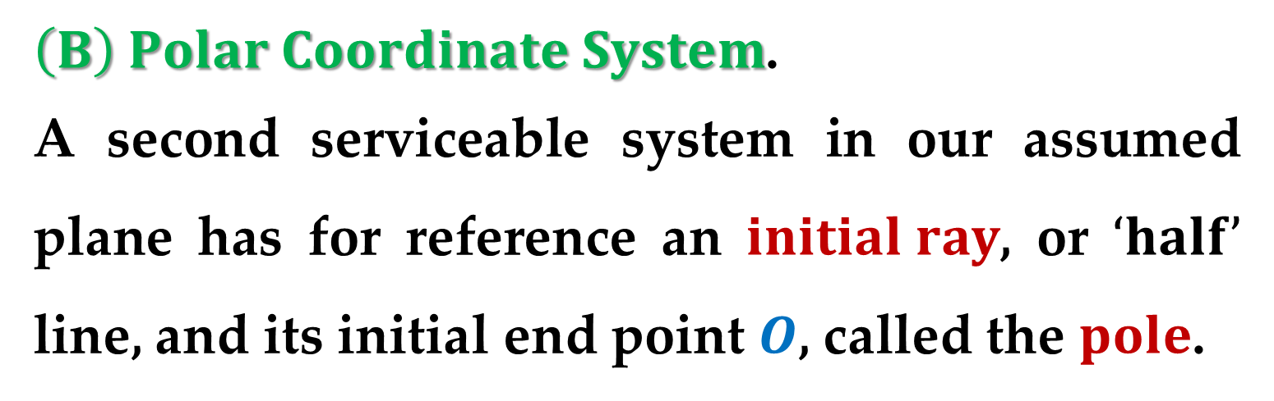
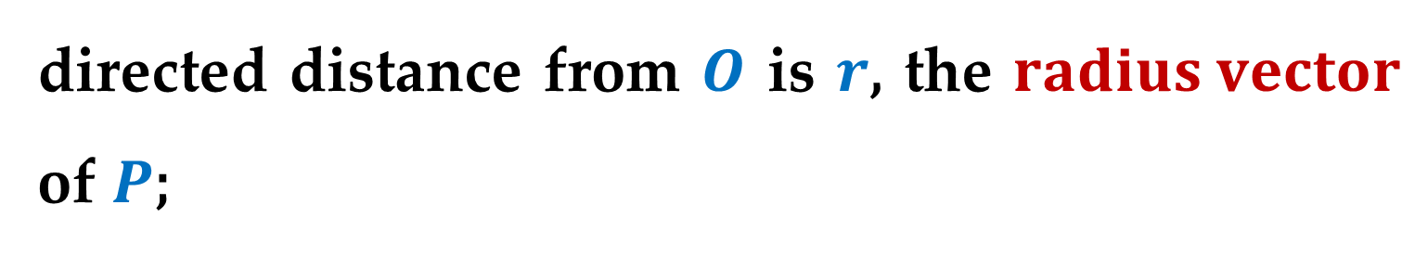
$\left(B\right) Polar Coordinate System$.
A second serviceable system in our assumed plane has for reference an $initial ray$, or $‘half’$ line, and its initial end point $O$, called the $pole$.
An ordered pair of numbers $\left(r, θ\right)$ then locates a point $P$ whose
directed distance from $O$ is $r$, the $radius vector$ of $P$;

Slide 21
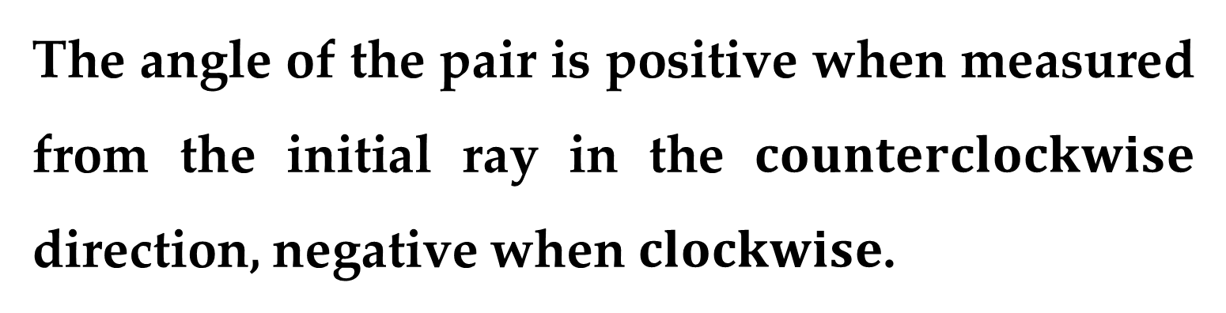
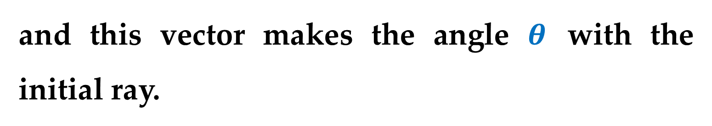
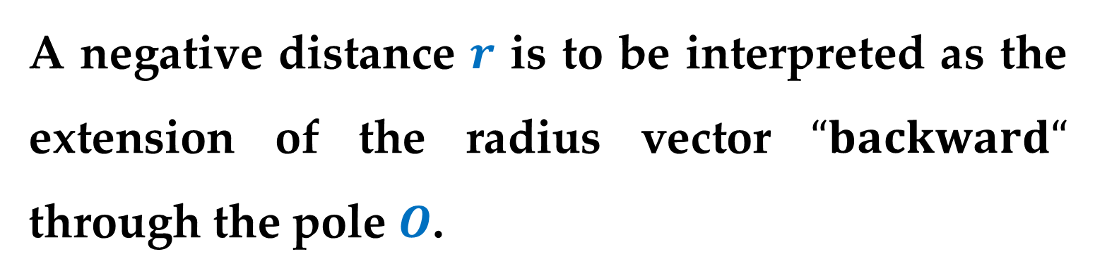
and this vector makes the angle $θ$ with the initial ray.
The angle of the pair is positive when measured from the initial ray in the $counterclockwise$ direction, negative when $clockwise$.
A negative distance $r$ is to be interpreted as the extension of the radius vector $“backward“$ through the pole $O$.

Slide 22
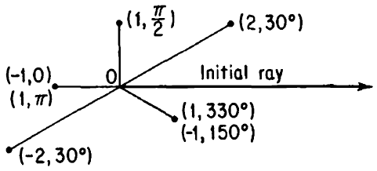
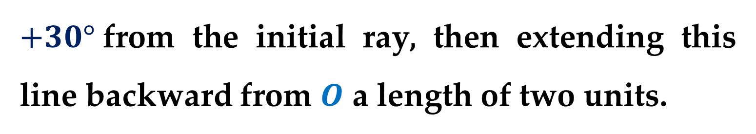
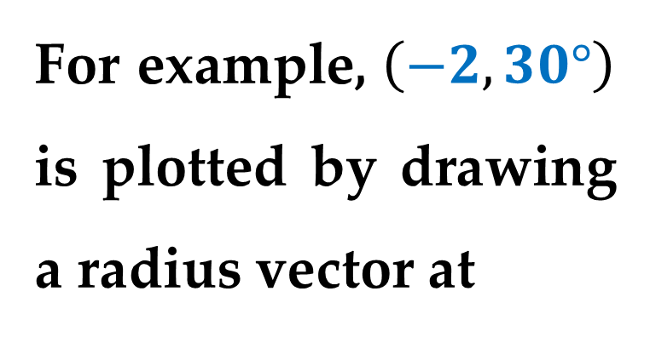
For example, $\left(−2, 30°\right)$ is plotted by drawing a radius vector at
$+30°$from the initial ray, then extending this line backward from $O$ a length of two units.
It should be noted that although a single point is determined by a given pair of polar coordinates, the converse is not true.

Slide 23
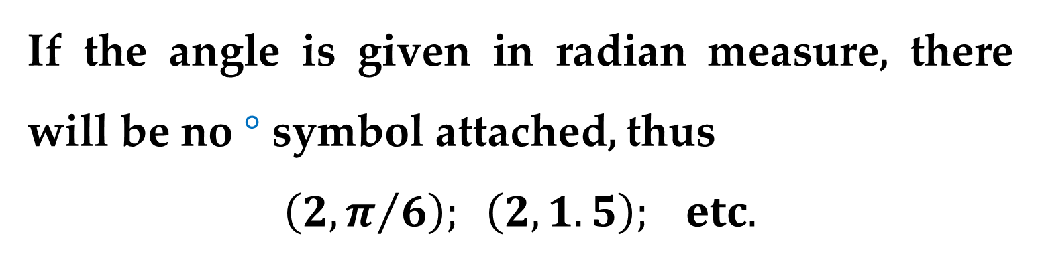
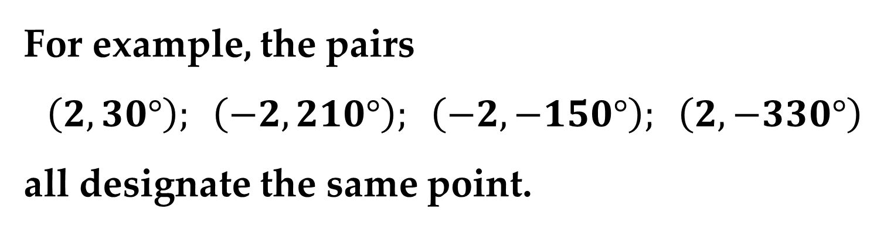
A selected point has an unlimited number of coordinate pairs.
For example, the pairs
$$\left(2,30°\right); \left(−2,210°\right); \left(−2,−150°\right); \left(2,−330°\right)$$
all designate the same point.
If the angle is given in radian measure, there will be no $°$ symbol attached, thus
$$\left(2,π/6\right); \left(2,1.5\right); etc.$$

Slide 24
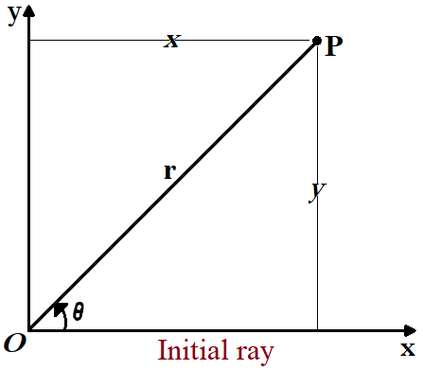


$\left(C\right) Exchange of Systems$.
The rectangular and polar coordinate systems may be exchanged one for the other by making the pole and the origin coincident, and the $x−$axis coincident with the initial ray.
Thus a point $P$ may have coordinates $\left(x, y\right)$ in the rectangular system and $\left(r, θ\right)$ in the polar system.

Slide 25


Relationships between these two sets of coordinates are apparently
$$\left\{\begin{matrix}x=r\cos{θ} \\ y=r\sin{θ}\end{matrix}\right. and \left\{\begin{matrix}r=\sqrt{x^{2}+y^{2}} \\ θ=\tan^{−1}{y/x}\end{matrix}\right.$$
These relationships permit the transfer of coordinates in one system to the other.
For example, $\left(\sqrt{3}, 1\right)$ in rectangular coordinates can be written as $\left(2, 30°\right)$ in polar coordinates.

Slide 26

Whereas $\left(−1,\frac{5π}{6}\right)$ in polar coordinates can be written as $\left(\frac{\sqrt{3}}{2},−\frac{1}{2}\right)$ in rectangular.

Slide 27


$Graphs: Mathematical Statements$
Equations or inequalities which relate $x$ and $y$ or $r$ and $θ$ define $loci$ in the reference plane.
That is, the set of those points (and only those) whose coordinates satisfy such a statement forms the graphical representation or $locus$ of the mathematical statement.
Numbers satisfying a mathematical statement are those which make the statement true.

Slide 28



For example, $3x+2y=12$ represents a straight line: the set of all points whose coordinates $\left(x, y\right)$ satisfy the equation.
All such pairs of numbers taken from the domain of all real numbers represent points on the line.
The line intercepts lengths of four and six units on the $x−$ and $y−$axes.

Slide 29



As another example, $r=2 sinθ$ represents a circle.
If we build a table of coordinates satisfying the equation, then the set of all such points will form the circle.
This circle passes through the pole (since for $θ=0,$ $r=0$) and has its center at $\left(1,π/2\right)$.

Slide 30


Let us determine the rectangular equation of this circle.
It is convenient (and legitimate) to multiply the equation first by $r$
$$r^{2}=2r \sin{θ}$$
before replacing these polar coordinates by their rectangular equivalents.
Since $r^{2}=x^{2}+y^{2}$ and $r\sin{θ}=y$, we have at once $x^{2}+y^{2}=2y$.

Slide 31




We will have occasion to determine points of the plane restricted by conditions of the sort
$$\left\{y≤1; y≥x^{2}\right\}$$
The set of points satisfying the first restriction, $y≤1$, is the shaded region (region $A$).
For all points in this region $x$ may be any real number, but $y$ may not be greater than $+1$.

Slide 32



The set for which $y≥x^{2}$ consists of those points on the parabola $y=x^{2}$ together with all points $‘above’$ the curve.
(region $B$)
The set of points common to the two sets (points whose
coordinates satisfy both conditions) is called their $intersection$ and denoted by the symbol $A∩B$.

Slide 33

This intersection set is shown as the cross-hatched region of the right-hand picture.

Slide 34




$Distance between Two Given Points$
Let $P$ and $Q$ be two points with coordinates $\left(x_{1},y_{1}\right)$ and $\left(x_{2},y_{2}\right)$.
Draw $PL$ and $QM$ perpendicular to the $x−$axis, and draw $QN$ perpendicular to $PL$ and $QM$.
$$OL=x_{1}; LP=y_{1};$$
$$OM=x_{2}; MQ=y_{2};$$

Slide 35



Then
$$QN=ML=OL−OM=x_{1}−x_{2};$$
$$NP=LP−LN=LP−MQ=y_{1}−y_{2};$$
In the triangle $∆PQN$:
$$PQ^{2}=QN^{2}+NP^{2}={\left(x_{1}−x_{2}\right)}^{2}+{\left(y_{1}−y_{2}\right)}^{2}$$
Therefore
$$PQ=\sqrt{{\left(x_{1}−x_{2}\right)}^{2}+{\left(y_{1}−y_{2}\right)}^{2}}$$
$$distance between points P and Q$$

Slide 36


$Note$: The distance of $P$ from the origin $O$ is
$$\sqrt{x_{1}^{2}+y_{1}^{2}}$$
$Example 1$.
If $P$ is the point $\left(4, 7\right)$ and $Q$ is $\left(2, 3\right)$, then
$$PQ=\sqrt{{\left(4−2\right)}^{2}+{\left(7−3\right)}^{2}}=\sqrt{4+16}=\sqrt{20}$$
$$=2\sqrt{5} units$$

Slide 37

$Example 2$.
The distance between the points $P\left(2,−5\right)$ and $Q\left(−4,7\right)$ is
$$PQ=\sqrt{{\left(2+4\right)}^{2}+{\left(−5−7\right)}^{2}}=\sqrt{36+144}=$$
$$=\sqrt{180}=6\sqrt{5} units$$

Slide 38



$Coordinates of the Point that Divides$
$$the Line Joining Two Given Points$$
$$in a Given Ratio$$
Let the two given points be $P\left(x_{1}, y_{1}\right)$ and $Q(x_{2}, y_{2})$.
Let the point $R$ divide the line $PQ$ internally in the ratio $l:m$.

Slide 39




Draw the lines $PL$, $QM$, and $RN$ perpendicular to the $x−$axis.
Draw the line $PS$ perpendicular to $RN$, and the line $RT$ perpendicular to $MQ$.
Let the coordinates of $R$ be $\left(x,y\right)$.
$R$ divides $PQ$ internally in the ratio $l:m$.
Then
$$OL=x_{1}; LP=y_{1}; OM=x_{2}; MQ=y_{2};$$

Slide 40


And
$ON=x; NR=y;$
$PS=LN=ON−OL=x−x_{1};$
$RT=NM=OM−ON=x_{2}−x;$
$SR=NR−NS=NR−LP=y−y_{1};$
$TQ=MQ−MT=y_{2}−y_{1}.$
Triangles $∆PSR$ and $∆RTQ$ are similar.
From similarity it follows that: $\frac{PS}{RT}=\frac{SR}{TQ}=\frac{PR}{RQ}=\frac{l}{m}$.

Slide 41


That is
$$\frac{PS}{RT}=\frac{l}{m}⟹\frac{x−x_{1}}{x_{2}−x}=\frac{l}{m} ⟹m\left(x−x_{1}\right)=l\left(x_{2}−x\right)$$
If we collect terms containing the unknown $x$ on one side of the equation, we will obtain:
$$x\left(l+m\right)=lx_{2}+mx_{1}$$
or
$$x=\frac{lx_{2}+mx_{1}}{l+m}$$

Slide 42


For the other unknown variable $y$, we obtain:
$$\frac{SR}{TQ}=\frac{l}{m}⟹\frac{y−y_{1}}{y_{2}−y}=\frac{l}{m}⟹$$
$$y=\frac{ly_{2}+my_{1}}{l+m}$$
Hence, the coordinates of $R\left(x,y\right)$ are
$$\left(\frac{lx_{2}+mx_{1}}{l+m}; \frac{ly_{2}+my_{1}}{l+m}\right)$$

Slide 43




$External Point of Division$
If the point $R^{′}$ divides $PQ$ externally in the ratio $l:m$, then
$\frac{PR^{′}}{R^{′}Q}=\frac{l}{m}⟹\frac{PR^{′}}{QR^{′}}=\frac{l}{−m}$
Choosing $m$ negative, we get the coordinates of $R^{′}$.
Therefore, the coordinates of $R^{′}$ are
$$\left(\frac{lx_{2}−mx_{1}}{l−m}; \frac{ly_{2}−my_{1}}{l−m}\right)$$

Slide 44

$Note$: If we take $l=m=1$ in the internal point of division, we get the coordinates of the midpoint.
Therefore, the coordinates of the midpoint of $PQ$ are
$$\left(\frac{x_{2}+x_{1}}{2};\frac{y_{2}+y_{1}}{2}\right)$$

Slide 45




$Centroid of a Triangle Given its Vertices$
Let $∆ABC$ be a triangle with vertices $A\left(x_{1}, y_{1}\right)$, $B\left(x_{2}, y_{2}\right)$ and $C\left(x_{3}, y_{3}\right)$.
Let $AA^{′}$, $BB^{′}$, and $CC^{′}$ be the medians of the triangle.
In geometry, a $median$ of a triangle is a line segment joining a vertex to the midpoint of the opposite side, thus bisecting that side.

Slide 46



Then $A^{′}$, $B^{′}$, and $C^{′}$ are the midpoints of the sides $BC$, $CA$, and $AB$, respectively.
The coordinates of $A^{′}$ are
$$\left(\frac{x_{2}+x_{3}}{2};\frac{y_{2}+y_{3}}{2}\right)$$
We know that the medians of a triangle are concurrent at the point $G$ called the $centroid$ and $G$ divides each median in the ratio $2:1$.

Slide 47


Considering the median $AA^{′}$, the coordinates of $G$ are
$$\left(\frac{1∙x_{1}+2∙\left(\frac{x_{2}+x_{3}}{2}\right)}{1+2};\frac{1∙y_{1}+2∙\left(\frac{y_{2}+y_{3}}{2}\right)}{1+2}\right)$$
That is
$$\left(\frac{x_{1}+x_{2}+x_{3}}{3};\frac{y_{1}+y_{2}+y_{3}}{3}\right) −$$
the coordinates of the point $G$.

Slide 48



$Area of a Triangle Given its Vertices$
Let the vertices of triangle $∆ABC$ be $A\left(x_{1}, y_{1}\right)$, $B\left(x_{2}, y_{2}\right)$ and $C\left(x_{3}, y_{3}\right)$.
Without loss of generality, we may assume that
$x_{1}≤x_{3}≤x_{2}$
and that $\left(x_{3},y_{3}\right)$ lies above the line segment connecting $\left(x_{1},y_{1}\right),\left(x_{2},y_{2}\right)$

Slide 49



Consider the three trapezoids whose vertices are
Trapezoid #1:
$$\left(x_{1},0\right), \left(x_{1},y_{1}\right), \left(x_{3},y_{3}\right), \left(x_{3},0\right)$$
Trapezoid #2:
$$\left(x_{3},0\right), \left(x_{3},y_{3}\right), \left(x_{2},y_{2}\right), \left(x_{2},0\right)$$
Trapezoid #3:
$$\left(x_{1},0\right), \left(x_{1},y_{1}\right), \left(x_{2},y_{2}\right), \left(x_{2},0\right)$$

Slide 50


The area of the triangle is equal to the sum of the areas of the first two trapezoids less the area of the third:
$$Area_{∆}=Area_{Trap \#1}+Area_{Trap \#2}−Area_{Trap \#3}$$
This results in the following relation:
$$Area=\frac{1}{2}\left(y_{1}+y_{3}\right)\left(x_{3}−x_{1}\right)+\frac{1}{2}\left(y_{3}+y_{2}\right)\left(x_{2}−x_{3}\right)−$$
$$−\frac{1}{2}\left(y_{1}+y_{2}\right)\left(x_{2}−x_{1}\right)$$

Slide 51



Simplifying the previous expression$,$ we get
$$Area=\frac{1}{2}\left(x_{1}y_{2}+x_{2}y_{3}+x_{3}y_{1}−x_{1}y_{3}−x_{2}y_{1}−x_{3}y_{2}\right)=$$
$$=\frac{1}{2}\left[\left(y_{2}−y_{3}\right)x_{1}+\left(y_{3}−y_{1}\right)x_{2}+\left(y_{1}−y_{2}\right)x_{3}\right]$$
$$…=\frac{1}{2}\left|\begin{matrix}x_{1} & y_{1} & 1 \\ x_{2} & y_{2} & 1 \\ x_{3} & y_{3} & 1\end{matrix}\right|$$
If the vertices do not occur in the order $x_{1}≤x_{3}≤x_{2},$ then the formula above may yield the negative value of the area.

Slide 52


If the vertex $\left(x_{3},y_{3}\right)$ is not above the line segment connecting the other two vertices$,$ then the formula may again yield the negative value of the area.
So, the area of the triangle whose vertices are $\left(x_{1},y_{1}\right),$ $\left(x_{2},y_{2}\right),$ and $\left(x_{3},y_{3}\right)$ is given by
$$Area=±\frac{1}{2}\left|\begin{matrix}x_{1} & y_{1} & 1 \\ x_{2} & y_{2} & 1 \\ x_{3} & y_{3} & 1\end{matrix}\right|$$

Slide 53

$Note$:
The area is positive or negative depending upon the order in which we take the points.
Since scalar area is always taken to be a positive quantity, we take
$$∆=\frac{1}{2}\left|\left(y_{2}−y_{3}\right)x_{1}+\left(y_{3}−y_{1}\right)x_{2}+\left(y_{1}−y_{2}\right)x_{3}\right|$$

Slide 54


$Note$: If the vertices of the triangle are $\left(0, 0\right)$, $\left(x_{1}, y_{1}\right)$, and $\left(x_{2}, y_{2}\right)$, then
$$∆=\frac{1}{2}\left|x_{1}y_{2}−x_{2}y_{1}\right|=\frac{1}{2}\left|\begin{matrix}x_{1} & x_{2} \\ y_{1} & y_{2}\end{matrix}\right|$$
$Example 3$. Finding the Area of a Triangle
Find the area of the triangle whose vertices are
$$\left(1,0\right), \left(2,2\right), \left(4,3\right)$$
$$∗∗∗$$

Slide 55



Suppose the three points in $Example 3$ had been on the same line.
What would have happened had you applied the area formula to three such points?
Consider$,$ for instance$,$
the collinear points
$\left(0,1\right), \left(2,2\right), \left(4,3\right)$
shown in the $Figure$.

Slide 56


The determinant that yields the area of the $“$triangle$”$ having these points as vertices is
$$±\frac{1}{2}\left|\begin{matrix}0 & 1 & 1 \\ 2 & 2 & 1 \\ 4 & 3 & 1\end{matrix}\right|=0$$
If three points in the $xy−$plane lie on the same line$,$ then the determinant in the formula for the area of a triangle turns out to be zero.

Slide 57

Test for Collinear Points in the $xy−$Plane
Three points $\left(x_{1},y_{1}\right),$ $\left(x_{2},y_{2}\right),$ and $\left(x_{3},y_{3}\right)$ are collinear if and only if
$$\left|\begin{matrix}x_{1} & y_{1} & 1 \\ x_{2} & y_{2} & 1 \\ x_{3} & y_{3} & 1\end{matrix}\right|=0$$

Slide 58


An equation of the line passing through two points in the $xy−$plane is derived from the test for collinear points.
Two-Point Form of the Equation of a Line
An equation of the line passing through the distinct points $\left(x_{1},y_{1}\right)$ and $\left(x_{2},y_{2}\right)$ is given by
$$\left|\begin{matrix}x & y & 1 \\ x_{1} & y_{1} & 1 \\ x_{2} & y_{2} & 1\end{matrix}\right|=0$$

Slide 59

$Example 4$. Finding an Equation of the Line
Passing Through Two Points
Find an equation of the line passing through the points $\left(2,4\right)$ and $\left(−1,3\right)$.
$$∗∗∗$$

Slide 60



$Area of the Quadrilateral Given its Vertices$
Let $ABCD$ be the quadrilateral with vertices $A\left(x_{1}, y_{1}\right)$, $B\left(x_{2}, y_{2}\right)$, $C\left(x_{3}, y_{3}\right)$, and $D\left(x_{4},y_{4}\right)$.
Draw $AP$, $BQ$, $CR$, and $DS$ perpendicular to the $x−$axis.

Slide 61



Then we have
$$Area of quadrilateral_{ABCD}=$$
$$Area of trapezium_{APSD}+Area of trapezium_{DSRC}+$$
$$+Area of trapezium_{CRQB}−Area of trapezium_{APQB}$$
$$=1/2\left(PA+SD\right)×PS+1/2\left(SD+RC\right)×SR+$$
$$+1/2\left(RC+QB\right)×RQ−1/2\left(PA+QB\right)×PQ$$
$$=\frac{1}{2}\left[\left(x_{4}−x_{1}\right)×\left(y_{1}+y_{4}\right)+\left(x_{3}−x_{4}\right)×\left(y_{3}+y_{4}\right)\right.+$$
$$+\left.\left(x_{2}−x_{3}\right)×\left(y_{2}+y_{3}\right)−\left(x_{2}−x_{1}\right)×\left(y_{1}+y_{2}\right)\right]$$

Slide 62


$$=\frac{1}{2}\left[\left(x_{1}y_{2}−x_{2}y_{1}\right)+\left(x_{2}y_{3}−x_{3}y_{2}\right)+\left(x_{3}y_{4}−x_{4}y_{3}\right)\right.+$$
$$\left.+\left(x_{4}y_{1}−x_{1}y_{4}\right)\right]$$
$Note$:
This result can be extended to a polygon of $n$ sides with vertices $\left(x_{1}, y_{1}\right)$, $(x_{2}, y_{2})$,…, $\left(x_{n}, y_{n}\right)$ as
$$Area=\frac{1}{2}\left[\left(x_{1}y_{2}−x_{2}y_{1}\right)+\left(x_{2}y_{3}−x_{3}y_{2}\right)+…+\right.$$
$$\left.+\left(x_{n}y_{1}−x_{1}y_{n}\right)\right]$$

Slide 63

$Locus$
When a point moves so as to satisfy some geometrical condition or conditions, the path traced out by the point is called the $locus$ of the point.
For example, if a point moves keeping a constant distance from a fixed point, the locus of the moving point is called circle and the fixed distance is called the radius of the circle.

Slide 64

Moreover, if a point moves such that its distance from two fixed points are equal, then the locus of the point is the perpendicular bisector of the line joining the two fixed points.
It is possible to represent the locus of a point by means of an equation.
Suppose a point $P\left(x, y\right)$ moves such that its distance from two fixed points $A\left(2, 3\right)$ and $B\left(5, −3\right)$ are equal.

Slide 65




Then the geometrical law governing this movement is $PA=PB ⟹$ $PA^{2}=PB^{2}$:
$${\left(x−2\right)}^{2}+{\left(y−3\right)}^{2}={\left(x−5\right)}^{2}+{\left(y+3\right)}^{2}$$
$$…⟹x^{2}−4x+4+y^{2}−6y+9=$$
$$=x^{2}−10x+25+y^{2}+6y+9$$
$$…⟹6x−12y−21=0$$
$$⟹2x−4y−7=0$$
Here, the locus of $P$ is a straight line.

Slide 66
Thank you for attention

